Slide 1
Theory of Self-Authorship
EDH 5045: Student Development Theories
Dr. Bradley Cox
By: Josh Davis, Amanda Peters, Ali Raza
April 6, 2015
Notes:
Josh
Considering that we have all read the assigned chapters, we want to focus on Marcia Baxter Magolda’s theory of self-authorship.

Slide 2
GREEK
Notes:
Josh
Today we will be discussing and reviewing the show Greek which is about a freshman student who goes to the same college that his sister goes to. So let’s review the characters that we want you all to focus on.

Slide 3
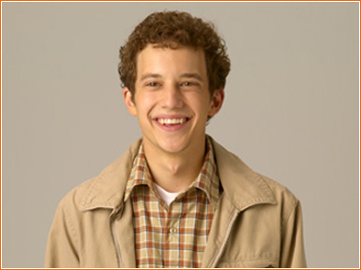
Rusty
Notes:
Ali

Slide 4
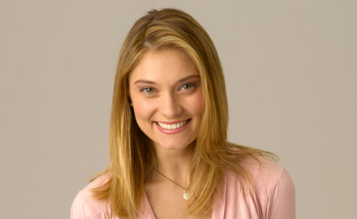
Casey
Notes:
Amanda

Slide 5
Calvin
Notes:
Josh

Slide 6
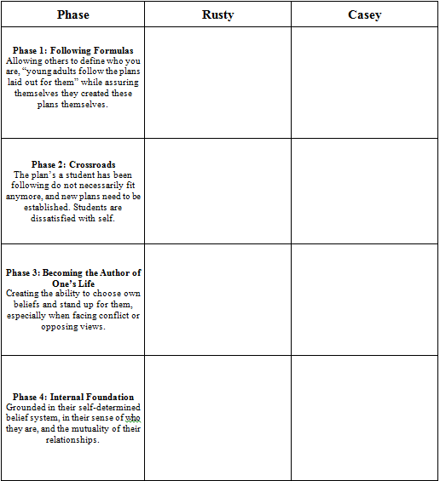
Let’s Watch!
Use your handout to process each character and take notes for further discussion.
Notes:
Josh

Slide 7
Rusty
Notes:
Ali
Where do you see Rusty at the beginning of the episode? What are some examples?
Can you identify any examples when Rusty made any progressions or regressions throughout the episode?
Where would you place Rusty at the end of the episode?

Slide 8
Casey
Notes:
Amanda
Where do you see Casey at the beginning of the episode? What are some examples?
Can you identify any examples when Casey made any progressions or regressions throughout the episode?
Where would you place Casey at the end of the episode?

Slide 9
Calvin
Notes:
Josh
Where do you see Calvin at the beginning of the episode? What are some examples?
Can you identify any examples when Calvin made any progressions or regressions throughout the episode?
Where would you place Calvin at the end of the episode?

Slide 10
Activity
Please disburse into your assigned groups and await further instructions:
Group 1: Junior, Mallory, Lane, Spencer, and Emily
Group 2: Christian, Jen, Kaitlyn, Amanda M., Taylor, Megan
Group 3: Kate M., Dish, Samantha, Matt J., Danielle, Kate H.
Group 4: Kyle, Morgan, Robin, Joe, Paola, Heather
Notes:
Amanda

Slide 11
Reflection
What were some of the biggest challenges you experienced in your groups?
What are your personal experiences with outside influences and becoming your own self-author?
How does it relate to what you experienced in your groups?
How can student affairs professionals help support students as they navigate challenges in becoming their own self-author?
Notes:
Ali

