Slide 1
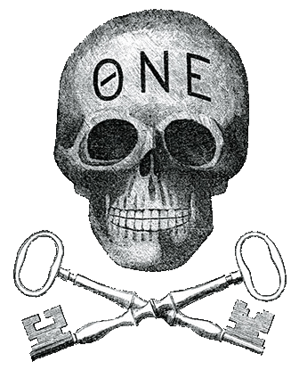
THE MACHINE AND ITS IMPACT
By: Emily Oswalt and Ali Raza

Slide 2
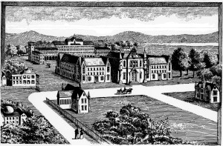
At the Start…
History of College Fraternities
University of Alabama Greek Life
Pre-Civil War
1857 ban
Going Underground
The Comeback - 1885
Theta Nu Epsilon

Slide 3
ΘΝΕ
TNE
Alpha Rho – 1888
Not recognized or chartered
1902 Charter, 1905 university recognition

Slide 4
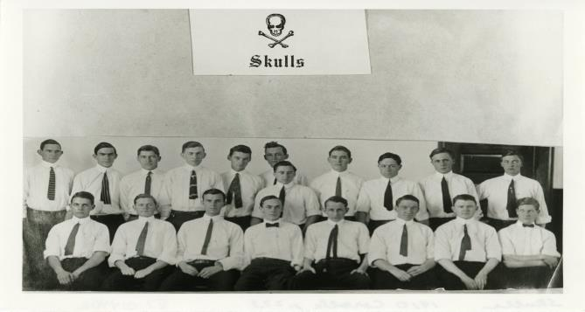
“The Skulls”
Replaces TNE 1909/1910
Elite “senior” members
Making decision for the organization
Secret and underground in nature

Slide 5
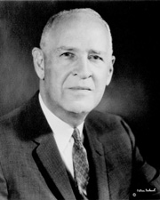
1914 - 1922
J. Lister Hill
Voting Block
1st UA Student Government Association President
TNE National revokes Charter
1922 – Skulls leave public view

Slide 6
SGA
Machine Control
Supported Candidates
SGA Composition
Machine Record
Less than 10/100 non-Machine
Structural Capacities

Slide 7
Cleo Thomas
1976 SGA Presidential Candidate
Ran against Machine supported candidate
Backed by Kappa Kappa Gamma
Machine is forced to extend membership to sorority women
Minority voices in SGA

Slide 8
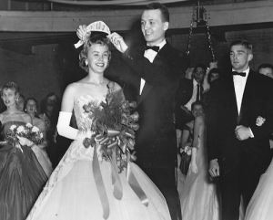
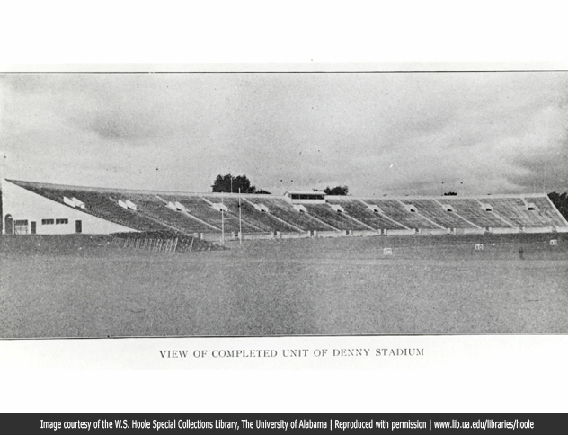
Across Campus…
Using intimidation tactics to:
Hold Leadership Positions
Homecoming Court
Blocked Seating at Football Games

Slide 9
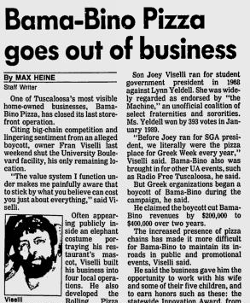
Tuscaloosa Community
Local business
Bama-Bino’s
Local Politics
2013 School Board Elections
Financial impact
Organizational dues
Budget allocates for:
Social functions
Political capital
Philanthropy

Slide 10
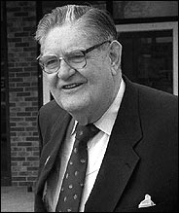
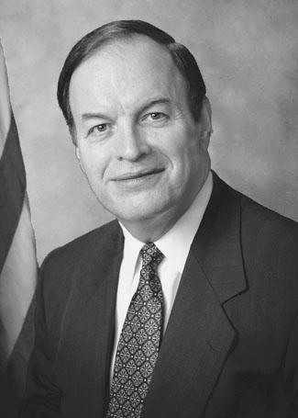
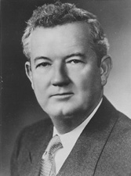
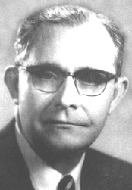
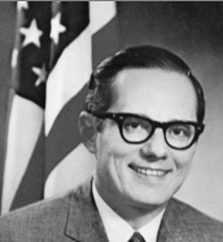
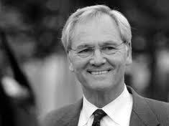
State and National Politics

Slide 11
Implications for Higher Education Professionals
Stakeholders
Alumni
University Staff/Administration
Political Officials
Community Identities
Lack of unity
Racial tensions
Ethics
When do you say something?
How do you advocate for all students if the system is meant for only 20% to have a chance succeed?
Notes:
20% of student population controlling nearly every elected office; how can it truly be representative of 100% of the population?
- Racial tensions pervasive; issues with segregation in Greek community even today with the scandal from last year

